Slide 1
DAPR Additional Data Updates
Joshua Terchek

Slide 2
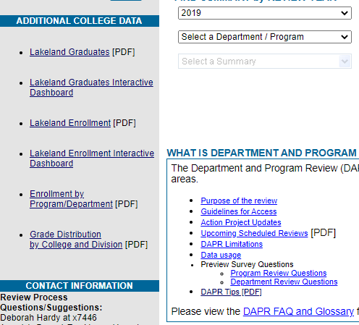
Additional College Data
On the DAPR webpage, we have some new charts that should be helpful in your program review.
https://lkn.lakelandcc.edu/apps/dapr/
These are available as interactive reports and in .pdf

Slide 3
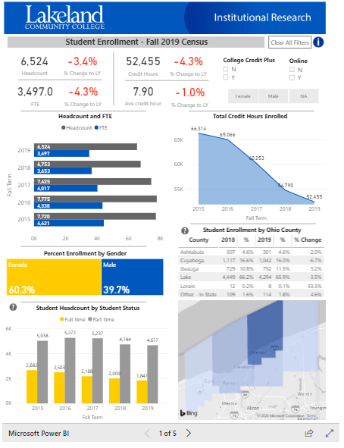
Enrollment Highlights
Links to the IR Website
Should give you a better understanding of the student body
Think of this as version 1.0.
  Give us suggestions on improving this!
  What would you like to know about students.

Slide 4
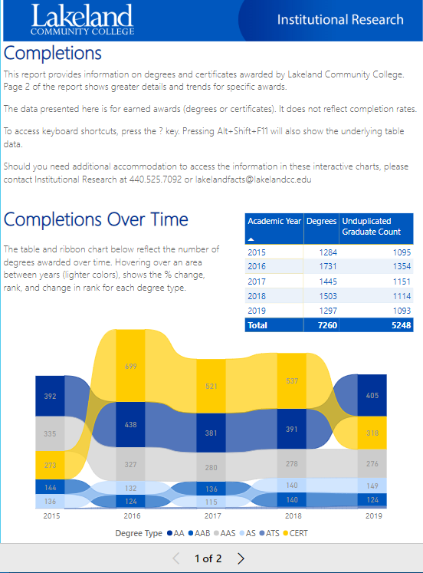
Completions
Completions shows completions at Lakeland overtime
Specific to DAPR
Allows you look at completions over time in your programs.
  CTRL will let you look at multiple degrees/certificates
Again, this is version 1.0.
  Make suggestions!

Slide 5
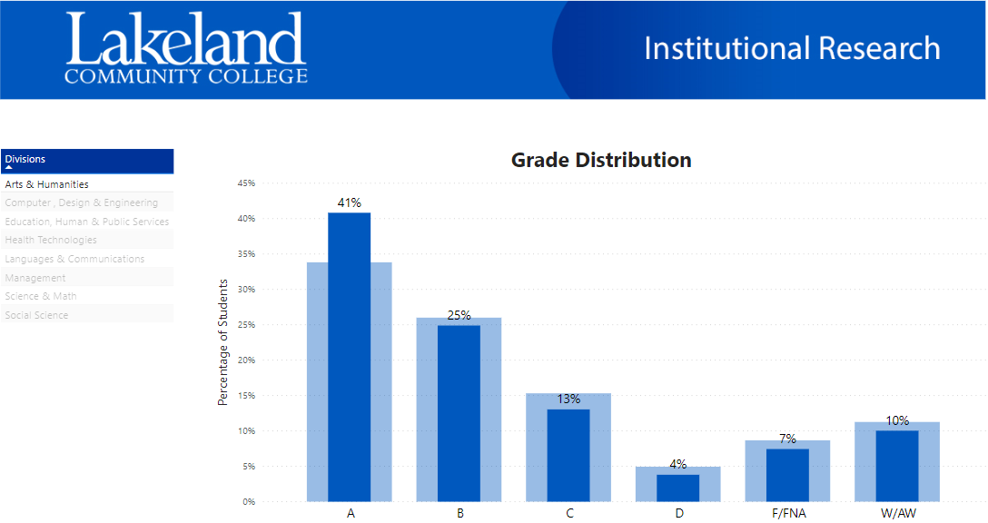
Grade Distributions
Grade Distributions
Interactivity should let you more easily compare.
Can select multiple areas

Slide 6
Next Steps
Making changes based on your feedback.
  Have an idea? Let us know!
  More reports to get you the data you need when you need it.
Email jterchek2@lakelandcc.edu

